Slide 1
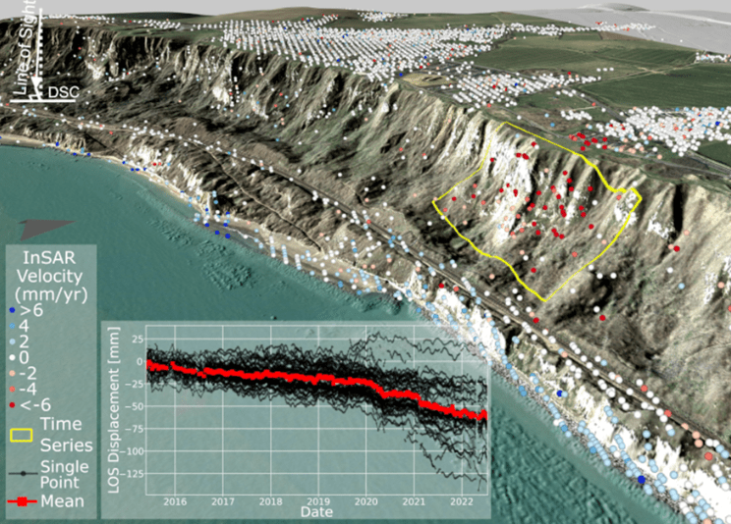
Title (max three rows), Calibri font, 88pt, bold
Title Row 2
Title Row 3
A.B. Surname¹, A.B.C. Surname^{1,2}, A-C. Surname¹ & A. Surname³
¹Department of earth sciences, Simon Fraser University, Burnaby, BC, CANADA
²Department/Unit (if desired), Company/Institute name, City, State/Province (if desired), Country
³Department/Unit (if desired), Company/Institute name, City, State/Province (if desired), Country
ABSTRACT
You do not need to repeat the abstract from your paper, unless it helps with communication.
presentation introduction
We ask you to bring along a physical poster (A0 portrait orientation, approx. 841 x 1189 mm). Authors need to bring their poster printed on the morning of 30 April 2026. You will be allocated a poster board number and on arrival at the conference (this will be the same number as your paper number).
Please locate your allocated board which will be located in the Level 5 Balcony Foyer.
Velcro dots will be provided and will be attached to the board for you to use. Posters will be on display throughout the entire workshop. We will ask poster presenters to stand with their poster at designated times so that people can converse with you about your paper.
Format
  Readable font
Use a Sans-Serif font for better on-poster readability. Calibri is recommended. Avoid serif fonts (like Times New Roman) for body text, as they can be harder to read in large blocks from a distance.
  High contrast
Use black text on a white background for maximum readability.
Avoid busy or dark backgrounds, which can make text disappear.
  Text and layout tips
Don't create a "Wall of Text“ – like this!
Use bullet points instead of long paragraphs.
Keep text concise. A poster is a visual summary and a conversation starter, not your full paper. Aim for around 300-800 words total.
Embrace whitespace. A clean, uncluttered layout is much more inviting and easier to read. Use columns (3 on a portrait A0 is standard) to organize your content.
  Graphics are key
Use high-resolution images, charts, and graphs to tell your story visually.
Ensure all graphics are clear and not pixelated. As a rule of thumb, images should be at least 150 DPI at their final printed size.
Preparing to print
Before you send your poster for its expensive A0 printing, print a small section of your poster on a standard A4 or Letter-sized paper at 100% scale.
Choose a slice that includes the title, a heading, some body text, and an image caption. Hold it at arm's length. Can you read it comfortably? This simple test will save you from discovering a critical readability issue after it's too late.
Format examples
Body text is Calibri, size 24-32. There is a 24 point space after each paragraph.
Top level titles are font size 36, ALL CAPITALS, colour 212,56,37.
Second level titles are font size 36, colour 113,17,42.
  Table and figure labels
It’s sometimes easier to insert tables as images.
Table 1: Table title (size 20-24).
Figure 2: Short description (size 20-24).
Figures can be pasted in on top of this text box – use simple return (enter button) spaces to fit the text around these.
  References
  You do not need to repeat all the references from your paper, only the ones referred to in the poster. Put references in the following format:
AGS (Australian Geomechanics Society). 2007a. Guideline for landslide susceptibility, hazard and risk zoning for land use management. Australian Geomechanics 42(1): 13-36.
AGS (Australian Geomechanics Society). 2007b. Commentary on guideline for landslide susceptibility, hazard and risk zoning for land use management. Australian Geomechanics 42(1): 37-62.
Clague, J.J. & Stead, D. 2012 (eds.). Landslides: Types, Mechanisms and Modelling. Cambridge University Press.
Jappelli, R. & Marconi, N. 1997. Recommendations and prejudices in the realm of foundation engineering in Italy: A historical review. In Carlo Viggiani (ed.), Geotechnical engineering for the preservation of monuments and historical sites; Proc. intern. symp., Napoli, 3-4 October 1996. Rotterdam: Balkema.
King, A.B. 1995. Codification of Serviceability Criteria of New Zealand. Journal of the New Zealand Structural Engineering Society 8(1): 23-28.
Lee, M. & Jones, D.K.C. 2023. Landslide Risk Assessment. 3rd Edition. ICE Publishing.
Specimen* | Ultimate Strength (kN) | Initial Stiffness (kN/mm) | Earthquake Record
Interior | 27 | 5.7 | 1.25 x El-Centro 1940
Exterior | 14 | 3.0 | NZS 4203 Matahina

